Slide 1
Flight Delay Model
By Will Bishop
Springboard Data Science Intensive
February 2017

Slide 2
Question and data
Part 1

Slide 3
Flight delay model goal
To predict the on-time performance of a flight based on:
Origin and destination cities
Airline
Time of year, time of day, day of week
Other variables if possible

Slide 4
Flight delay model data
Bureau of Transportation Statistics On-Time Performance Table
Includes every flight of major U.S. airlines since 1990
Used 5% random sample due to computer memory limitations
Added BTS crosswalks for airline names and market names

Slide 5
Client and usefulness
The ideal client is an application developer that helps travelers decide on the best flights
Google Flights
Kayak
Expedia
With a flight delay model, they can incorporate likely delay times as well as price

Slide 6
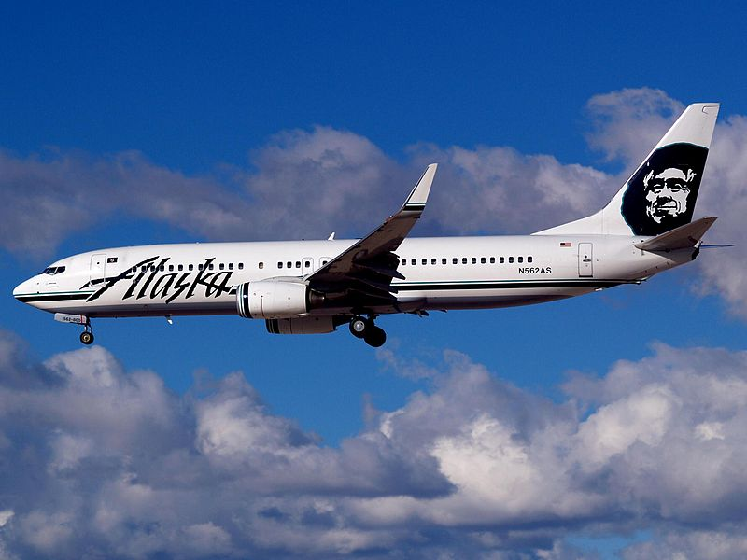
Descriptive statistics
Part 2
Notes:
Image source: https://en.wikipedia.org/wiki/Alaska_Airlines#/media/File:Alaska_Airlines_Boeing_737-890_N562AS.jpg

Slide 7
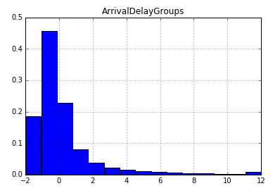
Delay times in 15-minute groups
Percentage of flights
Delay (minutes) / 15

Slide 8
Airlines by percentage of flights
Southwest 20%
Delta 13%
ExpressJet 11%
SkyWest 10%
American 10%
United 8%
Others 27%

Slide 9
Airlines by 15-minute delay rate
Highest delay rates
Spirit | 30%
Frontier | 24%
JetBlue | 22%
ExpressJet | 22%
Envoy | 22%
Lowest delay rates
Hawaiian | 8%
Alaska | 12%
Delta | 14%
AirTran | 15%
Mesa | 16%
Delay rate across all flights in data set: 19%

Slide 10
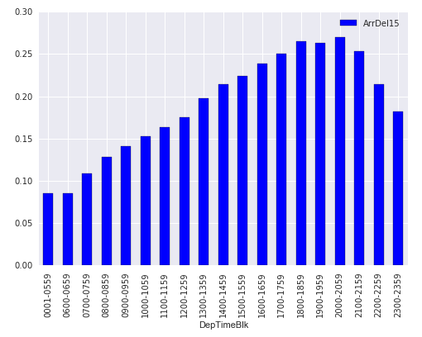
Delay rates by time of day
15-minute delay rate
Scheduled departure time (blocks)

Slide 11
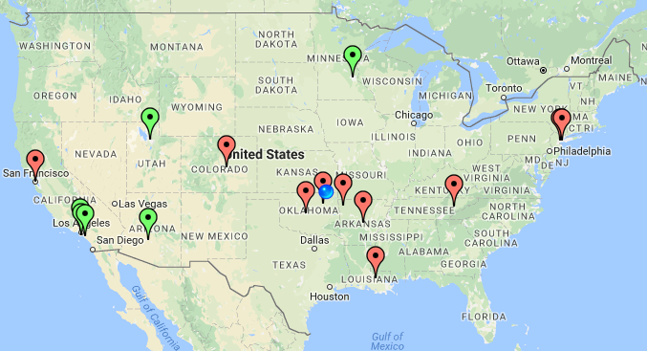

Destination cities by delay rate
Green: best 10 destination cities
Red: worst 10 destination cities
(At least 2,000 flights in data set)

Slide 12
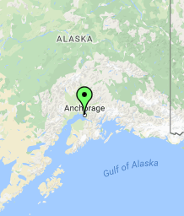
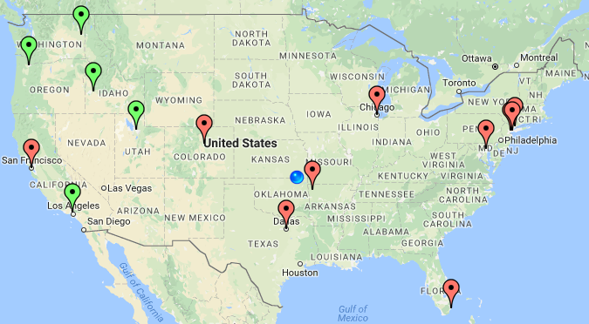

Origin cities by delay rate
Green: best 10 origin cities
Red: worst 10 origin cities
(At least 2,000 flights in data set)

Slide 13
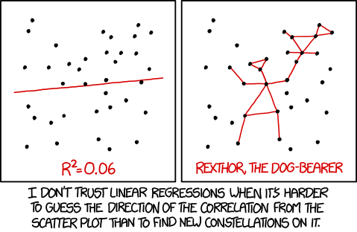
Linear regression model
Part 3
Notes:
Image source: Randall Munroe/XKCD, https://xkcd.com/1725/

Slide 14
Variables included
Dependent: Arrival delay time in minutes
Independent dummy variables:
Airline name
Origin and destination cities
Month
Time of day
Interaction between airline and airport if:
Airport has at least 1.5% of flights in data set

Slide 15
Linear regression technique
SGDRegressor from scikit-learn
Used partial_fit to allow large data set
Broke data into 15 batches of about 100,000 observations each
Each batch was 70% training data and 30% test data

Slide 16
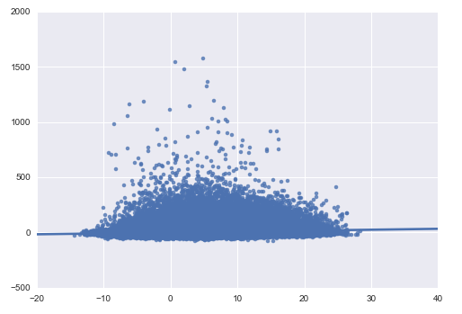
Predicted vs. actual values (test data)
Actual arrival delay (min)
Predicted arrival delay (min)

Slide 17
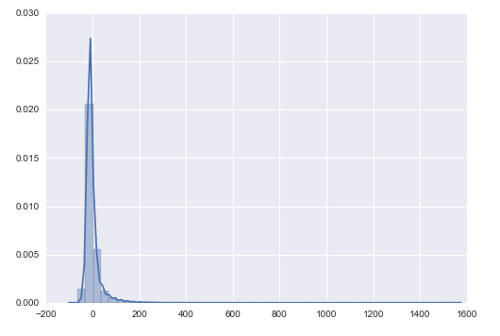
Histogram of residuals (test data)
Density
Residual arrival delay

Slide 18
Linear regression conclusions
Most variation in flight delays driven by factors outside this model
Extreme outliers (500+ minutes delay) are hard to predict and have no analogue on the negative side
However, the model does provide insights beyond descriptive statistics

Slide 19
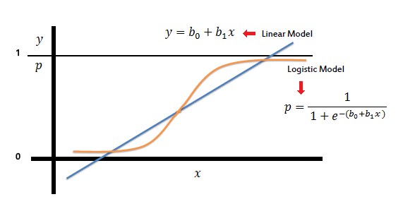
Logistic regression model
Part 4
Notes:
Image source: http://www.saedsayad.com/logistic_regression.htm

Slide 20
Logistic regression technique
Dependent variable: 15-minute delay binary
Independent variables: same as linear model
SGDClassifier from scikit-learn
Used loss = log to estimate probability of delay
Used L1 penalty to drive more coefficients to 0
Used partial_fit with 15 batches as in linear model

Slide 21
Logistic regression results
Simple measures of classifying power look very poor
Prediction score: 81% - no better than predicting “0” for every flight
F1 score: 0.0002
Confusion matrix:
15-minute delay? | Predicted no | Predicted yes
Actual no | 297,822 | 19
Actual yes | 68,475 | 7

Slide 22
Logistic regression results cont.
Consider different probabilities of delay as cutoff for a “positive” result
Example: confusion matrix with 20% probability cutoff is
15-minute delay? | Predicted no | Predicted yes
Actual no | 174,377 | 123,064
Actual yes | 31,105 | 37,377

Slide 23
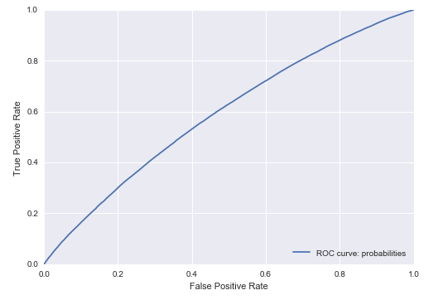
Logistic regression ROC curve

Slide 24
Overall conclusions
Flight delays are often driven by random events
Model needs more data and more variables in order to have predictive power
Our exploration and modeling still provides useful information on airlines, airports, and times of day to avoid flight delays

